Slide 1
Neutrino Nobel Prize overview
Slides provided by the University of Calgary, Dept. of Physics and Astronomy, Outreach Committee
Prepared by J. M. K. C. Donev

Slide 2
Neutrinos are fundamental particles
Notes:
One of the fundamental building blocks of the universe.

Slide 3
Same family as electrons
Spin ½
Lepton
means light particle
Most abundant particles with mass in the universe
Trillions go through you every second, with no effect
Notes:
Neutrinos are made in the centre of the sun, and pass through the sun without interacting at all! They are very weakly interacting.

Slide 4
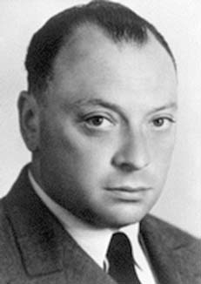
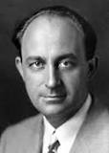
‘neutrino’ = Little neutral one
Pauli
Beta decay
Observationally didn’t seem to conserve momentum or energy
Proposed by Pauli in 1930
Carries momentum and energy
Fixed the momentum and energy problem, but couldn’t be detected!
No electric charge
Pauli called it a ‘neutron’; Fermi changed the name to Italian ‘neutrino’ in 1934
Fermi
Notes:
Wolfgang Pauli is on top, Enrico Fermi is on bottom. Neutrino means little neutral one in Italian.

Slide 5
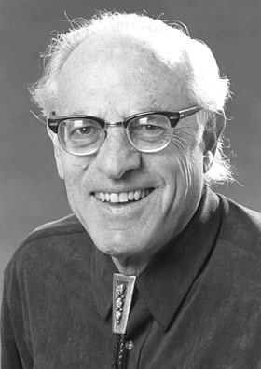
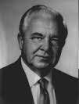
Reines and Cowan
Finally detected neutrinos in 1953 at Hanford
Reines won the Nobel Prize in 1995
Cowan had died; Nobel can’t be awarded posthumously.
Reines
Cowan
Notes:
Reines on left, Cowan on right
Used the neutrino flux from the nuclear reactor to get enough neutrinos to detect.

Slide 6
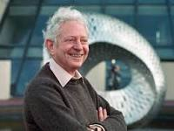
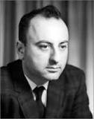
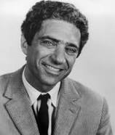
Lederman, Schwartz and Steinberger
1988 Nobel Prize in physics for the neutrino beam method and showing that there are two different neutrinos
This Nobel prize, related to the second (muon) neutrino, was awarded seven years before the Nobel prize for the experimental work, done decades before, that detected the first (electron) neutrino
Lederman
Schwartz
Steinberger
Notes:
This neutrino goes with the muon, another fundamental particle that’s like a big electron.
Lederman (left), Schwartz (centre) and Steinberger (right)

Slide 7
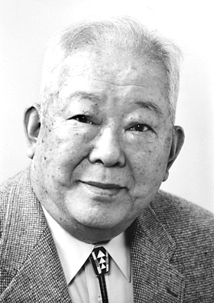
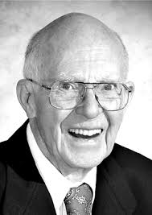
Koshiba and Davis (2002)
Nobel Prize for the detection of cosmic neutrinos
Koshiba
Davis
Notes:
Cosmic neutrinos are useful for seeing nuclear interactions in space, it’s another window into the universe. Koshiba (left) and Davis (right)

Slide 8
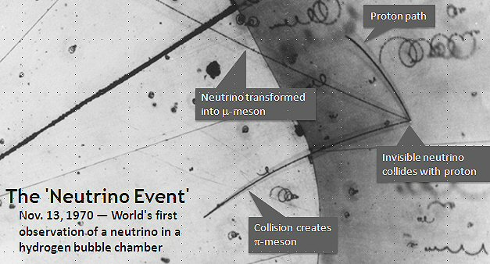
Neutrinos are hard to detect
Notes:
Neutrino comes in from the bottom right corner and hits a proton in a chamber filled with hydrogen gas at the right pressure and temperature. It ran into a proton (the hydrogen) and made the proton shoot off along the proton path), the neutrino transformed into a mu-meson and created a pi meson. This was not the first observed neutrino, but the first of this type of observation.

Slide 9
3 flavours (types)
Each flavour/type corresponds to another particle
Electron →
Electron neutrino
Muon →
Muon neutrino
Tau →
Tau neutrino
Notes:
Particles come in groups, like on the periodic table.

Slide 10
Fusion in the sun creates the solar neutrino problem
Gives off neutrinos
Fewer neutrinos detected than theories about the sun predict

Slide 11
REALLY bizarre
Notes:
This is like an elk jumping and turning into a magpie and then into a tiger before it lands.
The neutrino is the only particle that changes itself spontaneously back and forth among different types while far from other particles.

Slide 12
Neutrino oscillations
Notes:
The number of neutrinos are conserved, but the specific types change, after the 8 minutes that it takes to get from the sun, they’re all mixed up.

Slide 13
Neutrino mass
Mass required to make the oscillations happen (proposed by Wolfenstein, Mikheyev and Smirnov)
Can’t directly measure the mass
Notes:
The 𝜈_𝑒→𝜈_𝜇→𝜈_𝜏→𝜈_𝑒 are called neutrino oscillations because the type of neutrino that it is oscillates back and forth. Quantum mechanics says that we need mass to make this happen.

Slide 14
Mass of leptons
Mass of an electron (m_{e-}) = 1800x smaller than the mass of a proton
Muon is ~200 x m_{e-}
Tau is ~3500 x m_{e-} (bigger than a proton)
Neutrinos? Smaller than the electron mass, but how big? Open question!
Notes:
Electrons are much lighter than muons. Tau weighs even more. The electron neutrino is known to be very much lighter than an electron, but no one knows exactly how much.

Slide 15
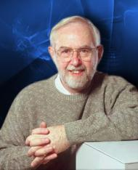
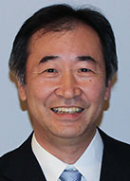
October 6th 2015 - Nobel prize awarded for experimentally detecting the changing flavours neutrinos!
Art McDonald
Takaaki Kajita
Notes:
Art McDonald and Kajita have been able to experimentally show that the neutrinos change types (flavours) using brilliant research and a huge international team based in Canada and Japan. They could detect the electron neutrinos and the total of all three neutrino types (flavours).

Slide 16
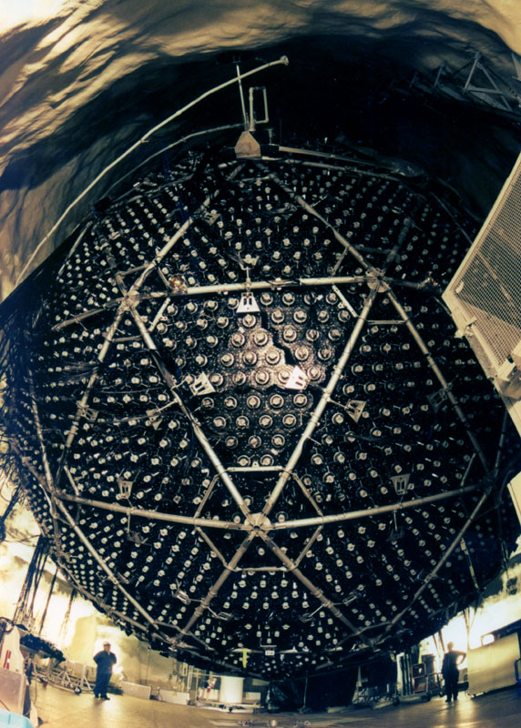
Sudbury Neutrino Observatory (SNO)
Notes:
An actual picture of the SNO lab deep underground.

Slide 17
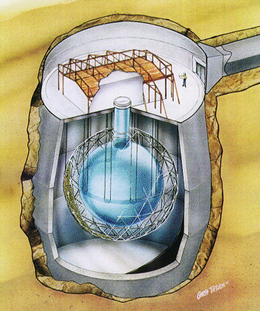
2 km underground
in Sudbury, Ontario, Canada
within Vale nickel mine
Uses D₂O (heavy water) and Cherenkov radiation
Notes:
Heavy water (D₂O) is one of the ways of detecting neutrinos. The neutrinos cause nuclear processes to happen that can be detected. It needs to be deep underground to shield the detector from cosmic rays.

Slide 18
D₂O made by Atomic Energy of Canada Limited (now CANDU Inc. and Canada Nuclear Labs)
Notes:
The Canadian nuclear power industry lent the needed D₂O to SNO labs.

Slide 19
Much yet to discover!
Are neutrinos their own anti-particle?
Do neutrinos and anti-neutrinos behave differently?
What are the masses of the 3 neutrinos?
Are there only 3 neutrinos?
How do neutrinos mix their flavours?
Notes:
Science is a constant evolving process, there are more Nobel prize level questions left to be answered by Canadians engaged in fundamental science research!

Slide 20
Some resources on neutrinos
Overview:
http://www.nu.to.infn.it/
http://www.nobelprize.org/nobel_prizes/physics/laureates/2015/
http://hyperphysics.phy-astr.gsu.edu/hbase/particles/neutrino.html#c1
The solar neutrino problem:
http://www.sns.ias.edu/~jnb/
SNO:
https://www.snolab.ca/
http://hyperphysics.phy-astr.gsu.edu/hbase/particles/sno.html
Super-Kamiokande:
http://www.ps.uci.edu/~superk/sk-info.html
http://www-sk.icrr.u-tokyo.ac.jp/sk/index-e.html
IceCube (south pole observatory):
https://icecube.wisc.edu/info/neutrinos

